Slide 1
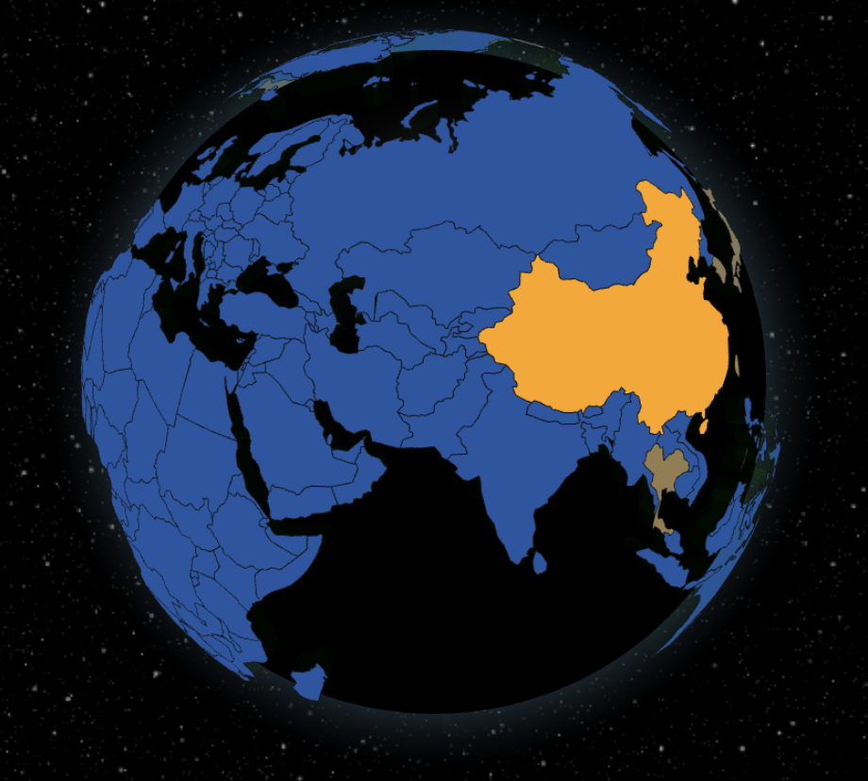
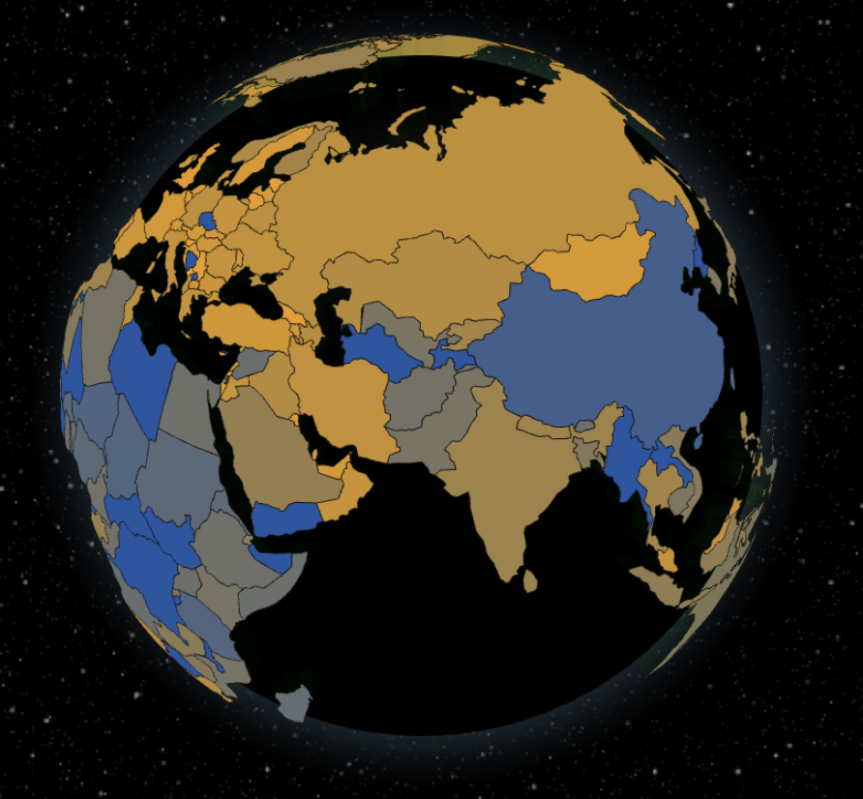
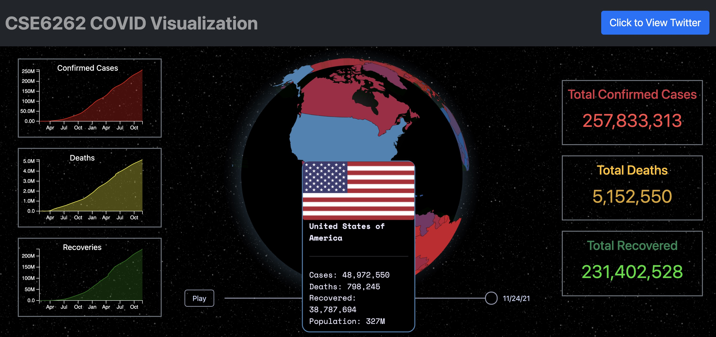
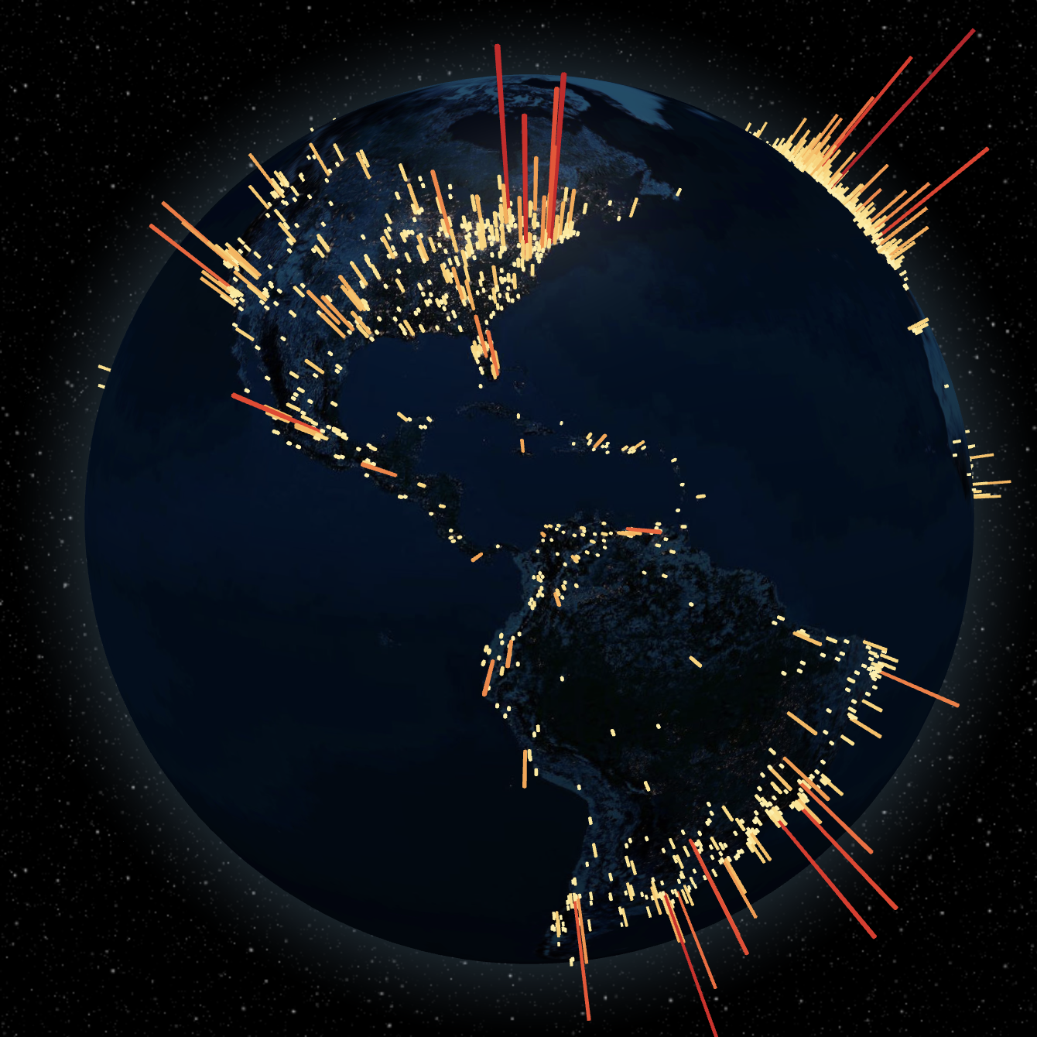

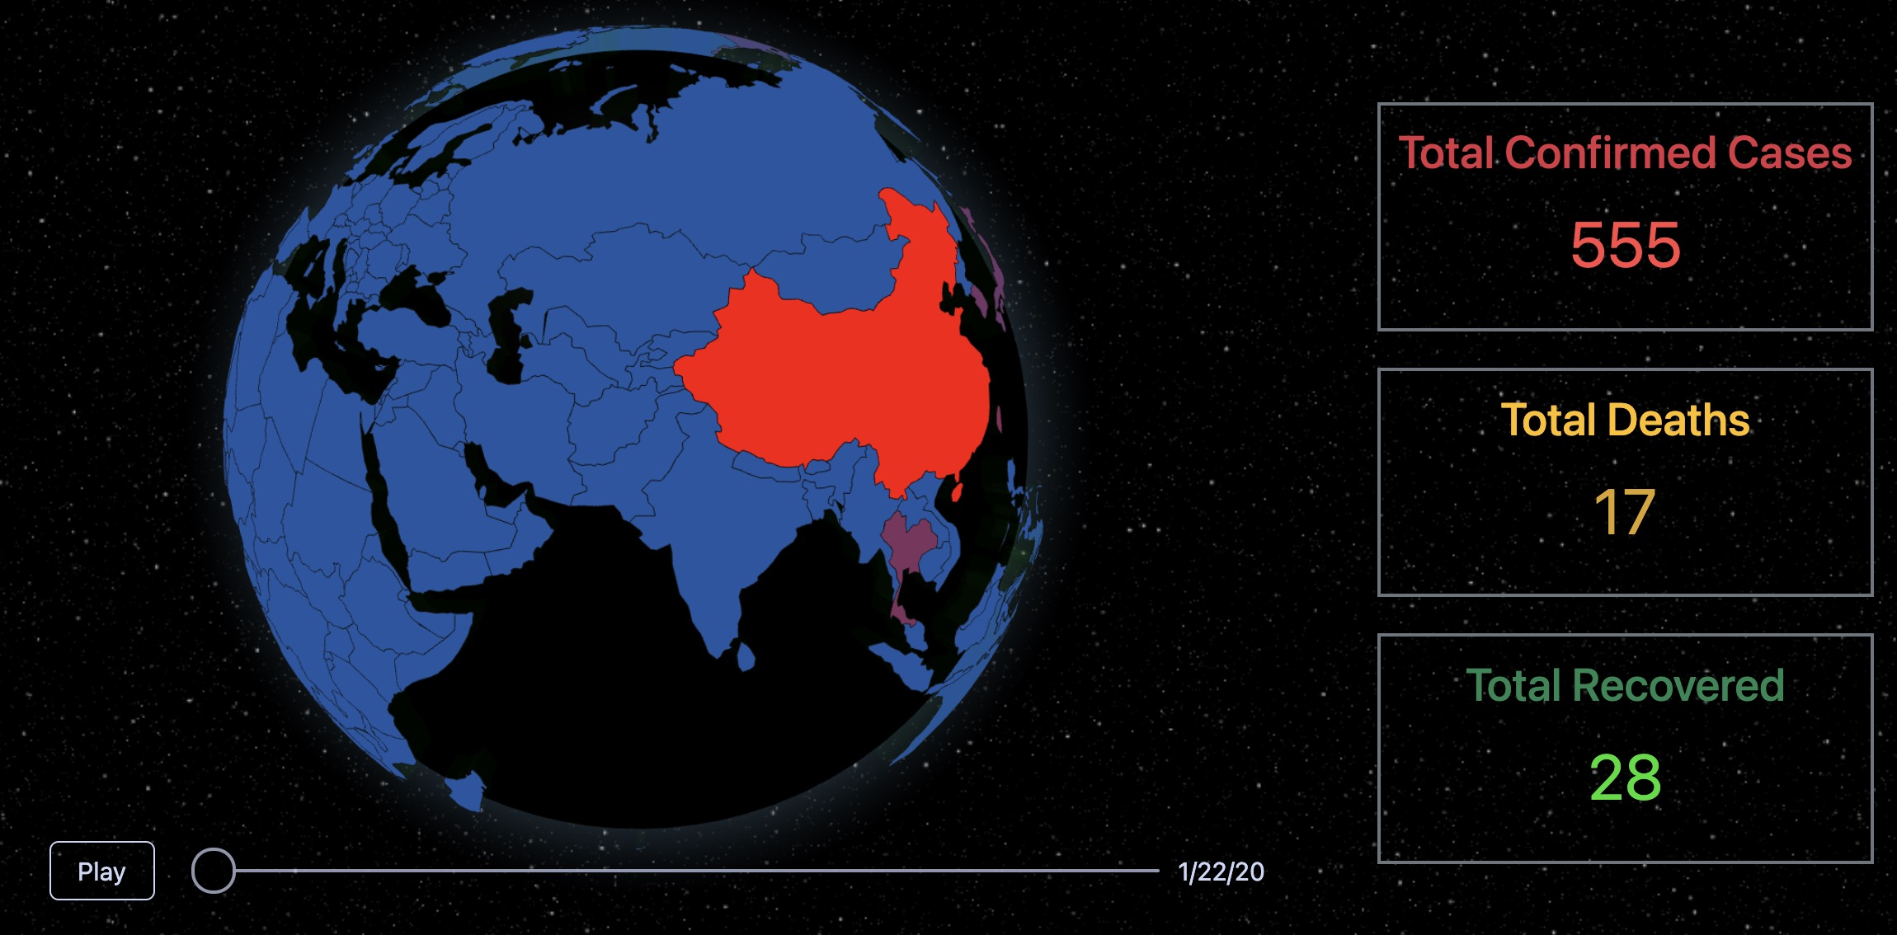
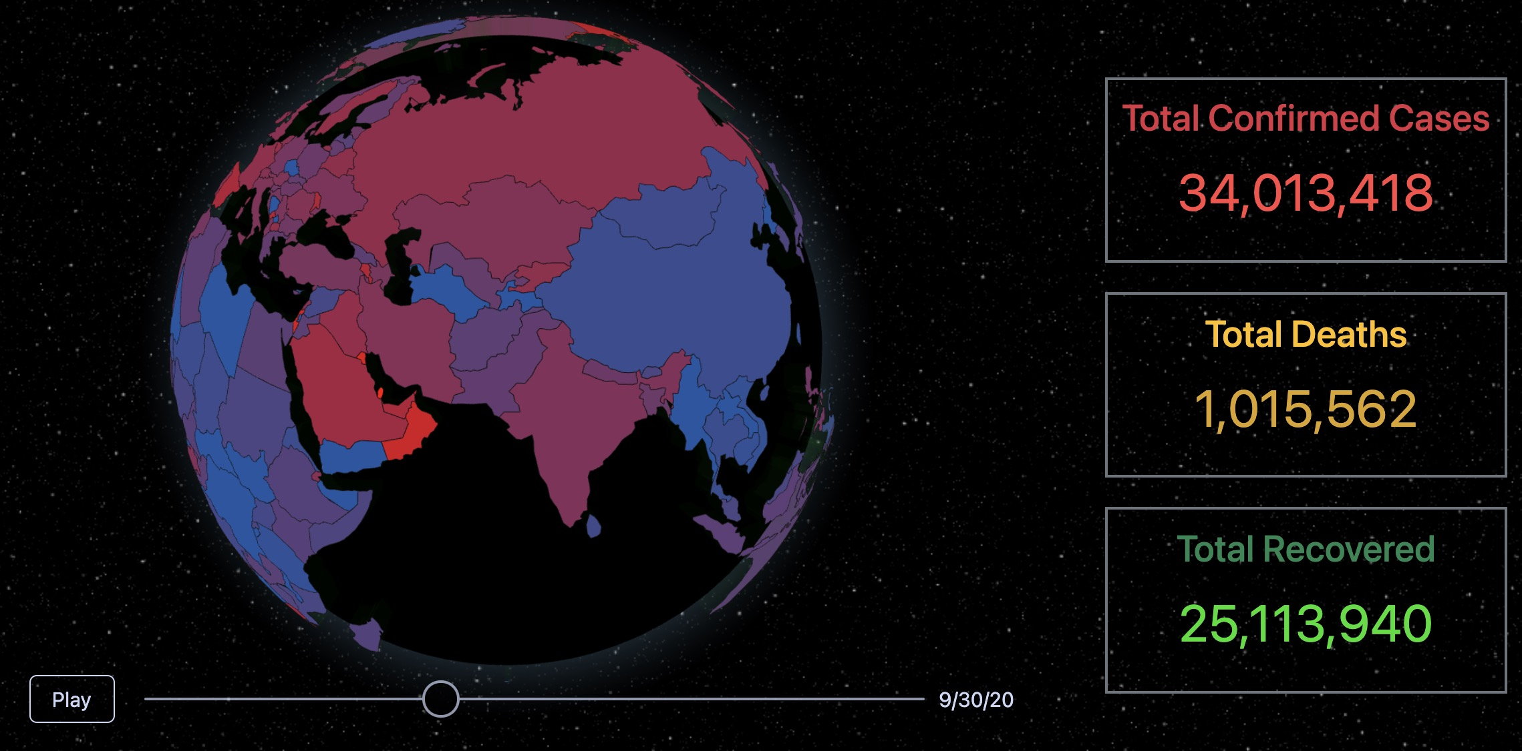
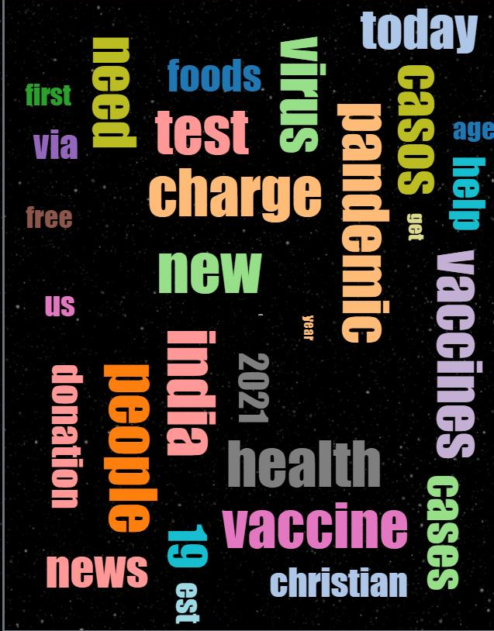
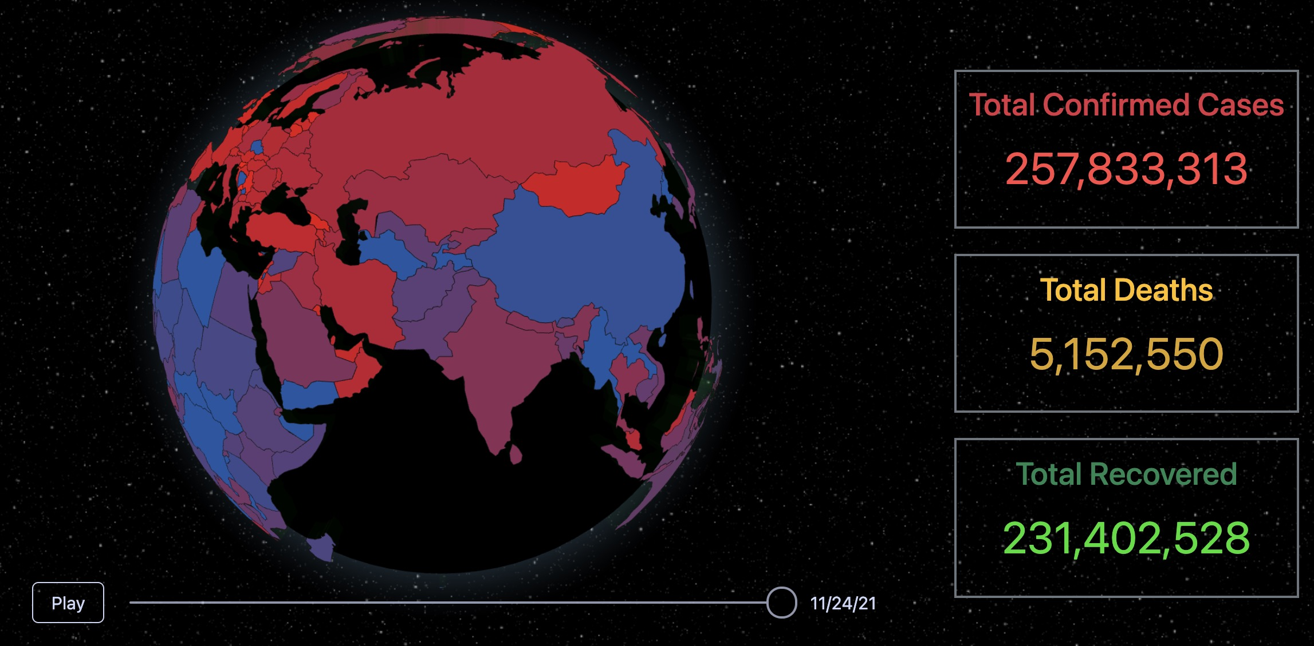
Shengyun Peng Junyan Mao Guanchen Meng Zefang Liu Yuxuan Wang Huili Huang
COVID-19 GLOBAL VISUALIZATION
INTRODUCTION AND MOTIVATION
DATASETS
Twitter as a leading social platform, generates over 800 million Tweets in a single day. The discussions focus on COVID-19 is too overwhelming for us to extract the useful information. Also, current COVID-related websites only provide visualizations on daily cases. The relationship between COVID-19 and twitter topics has not been fully explored yet. Therefore, we would like to
Demonstrate how COVID-19 spread across the world.
Manifest the correlation between trend in tweets and actual COVID-19 trend.
Present a word cloud of most frequently occurring tokenized words.
By performing the above visualizations, the project goal wishes to:
Evaluate the relationship between the COVID-19 cases and number of tweets in each country.
Provide data visualization to assist users make decisions regarding pandemic.
Give users an overview of the most popular topics about COVID-19 on Twitter.
- Dataset-1: COVID-19 daily cases
COVID-19 data is provided by the Center for Systems Science and Engineering (CSSE) at Johns Hopkins University, which has COVID-19 cases by day, month and year.
- Dataset-2: COVID-19 Twitter chatter dataset
This dataset is maintained by the Panacea Lab at GSU. It consists of COVID-19-related tweets acquired from the Twitter Stream related to COVID-19 chatter and provides top 1000 frequent terms, bigrams, and trigrams. Due to limited computing power, we picked a period of interest (March 1 to April 15, 2021) to capture the second spike of COVID-19 cases in the U.S.
GLOBAL COVID-19 VISUALIZATION
COVID-19 TWEET VISUALIZATION
COVID-19 TWITTER WORD CLOUDS
Approaches:
6000 tweets with geographic coordinates selected from 408312 COVID-19 related tweets in the March and April 2021.
World population globe used for visualizing tweets locations effectively.
Bars with higher heights and red color for more tweets from one position.
Twitter data visualization by geographic coordinates presenting tweets intuitively and innovatively compared by countries.
Experiments and results:
Legibility of the geographic data, density of coordinates, and distinctiveness of colors used for evaluating visualizations.
A globe with bars presented as results.
World population globe with proper longitude and latitude data giving the clearest result.
We present two word cloud experiment results to reflect the correlation between the epidemic and Twitter data.
Generate word cloud of during the COVID-19 second wave.
Generate animated word cloud to show the most popular COVID-19 topic in each month from Jan-Apr 2021.
Prove the change of Twitter topics is related to COVID-19 situation.
User interface of the global COVID-19 cases: 1) line charts, 2) total number,
3) country-wise cases of the selected date in the slide bar, and 4) the navigation bar.
Dragging along the slide bar displays daily COVID-19 case data and each country changes to corresponding color scheme. Meanwhile, the total cases are dynamically displaying on the right.
Fig 1.Word cloud for COVID-19 second wave
CONTACTS
speng65@gatech.edu, ywang3336@gatech.edu,
gmeng9@gatech.edu, liuzefang@gatech.edu, jmao@gatech.edu, hhuang413@gatech.edu
Fig 2.Word cloud animation

